Slide 1
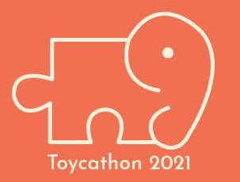
TOYCATHON 2021
(DIGITAL EDITION)
TEAM FORCA FANATICS

Slide 2
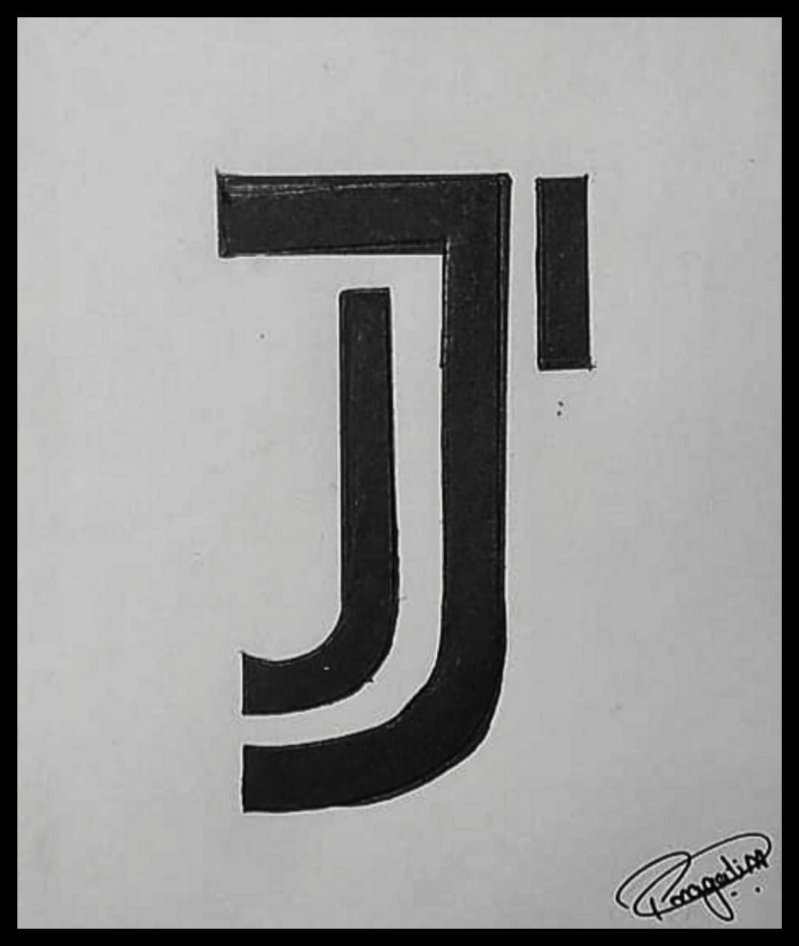
JABALI: Revisiting the lost
JABALI: Revisiting the lost
ruins
Learning about our cities in a fun way ,with a pinch of technology

Slide 3
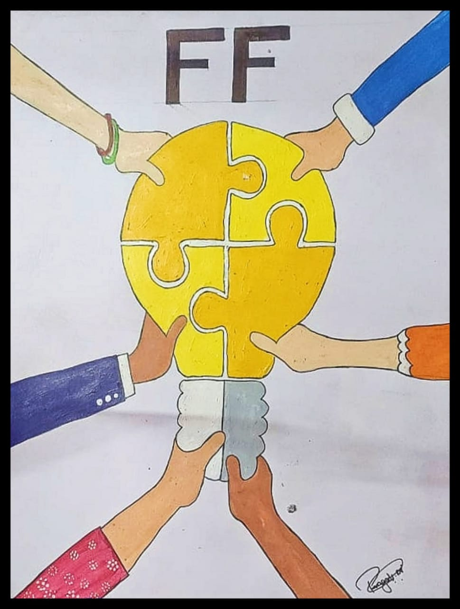
OUR TEAM –
TEAM NAME - Forca Fanatics TEAM MEMBERS - Guneet Singh Kapoor
Mayank Gupta Ishita Kumar Rahul Chelani Pragati Nashine Priyanshi Rai TEAM MENTOR - Prof. Saurabh Sharma COLLEGE NAME - Gyan Ganga College of Technology, Jabalpur(M.P.)

Slide 4
SOME POINTS TO PONDER
Indian toy market stands at around $1.75B around 0.8% of the worlds toy market pegged i.e. at around $90B.
As for the Indian app market it is in a much better condition after the ban on various Chinese apps on Nov 2020.
The rise in the Indian app market is a major cause for the popularization of Indian apps both here and globally.
Since the Indian app market is also very free, so many new innovations can be made as creators don't have to worry about violating terms or conditions unlike our neighbour China.

Slide 5
WHY DOES THIS HAPPEN?
There are numerous reasons donating to this condition of the Indian toy market, but there are 2 major reasons responsible for the same:
80% of the toys circulating in India are imported from China.
Mass production is a problem with Indian toys which is not so economical, this is one of the main reasons Chinese toys are opted instead of Indian toys.

Slide 6
OUR PLAN:
In a nutshell, we focus on designing an online game application consisting of , riddles related to the place you Scan Code or on the basic of your location which will help you to learn about the place monument.

Slide 7
HOW IT WORKS?
The working of the app is pretty simple and can be divided into 4 parts:
Login into the app.
Scanning the QR code.
Playing the quiz & securing points.
Redeeming the points.

Slide 8
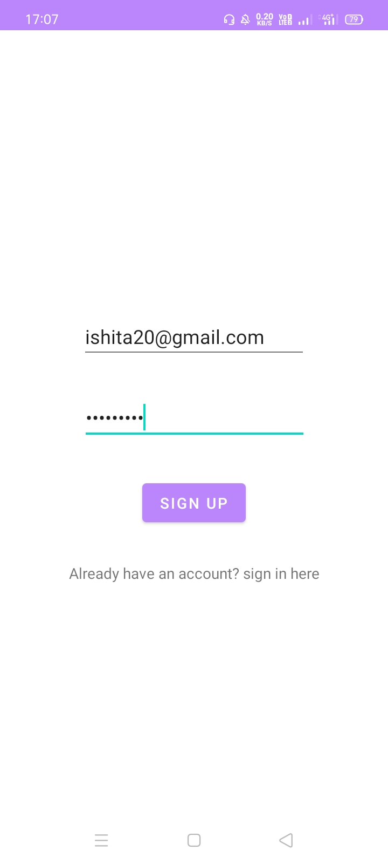
1.LOGIN INTO THE APP:
As the user opens the app for the first time, he/she will see a screen for signing up into the app.

Slide 9
If the user has already signed up, i.e. they've already registered into the app they will click onto the text encircled text which will redirect them to the sign in(log in)
page from where they can access the quiz as shown:

Slide 10
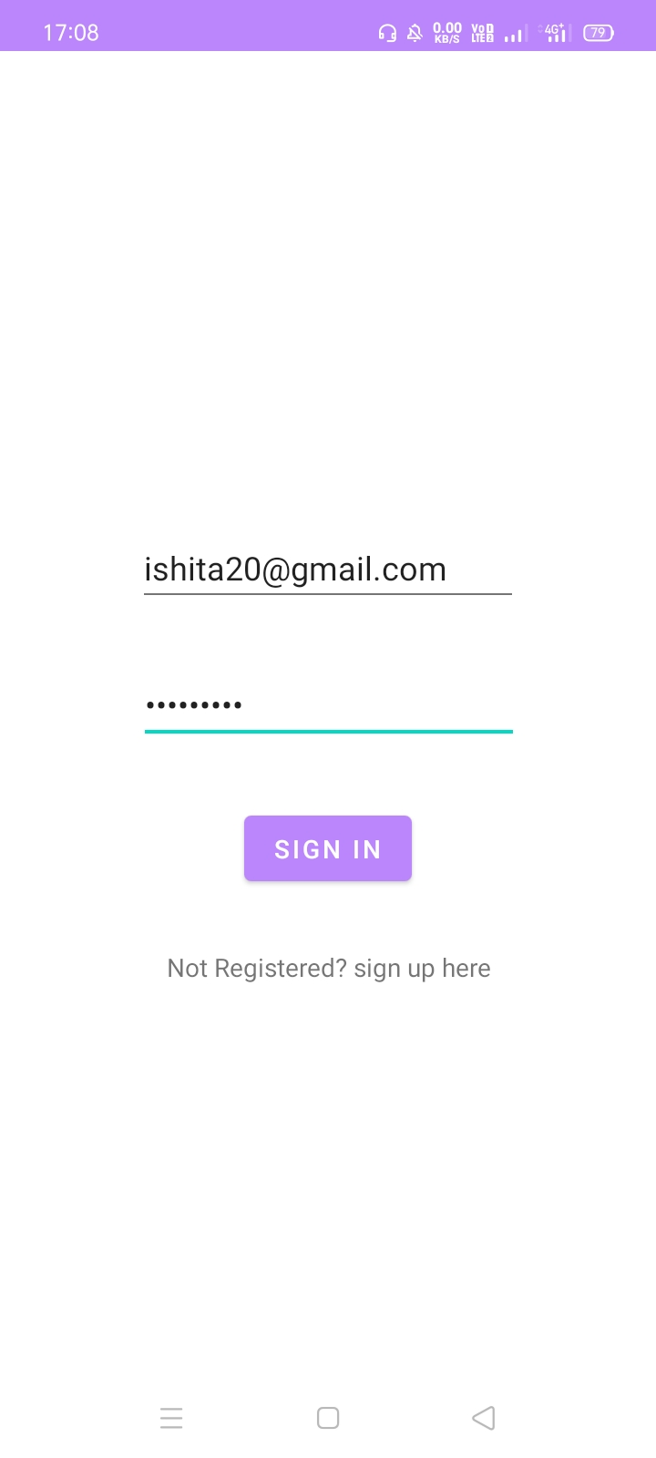

Slide 11
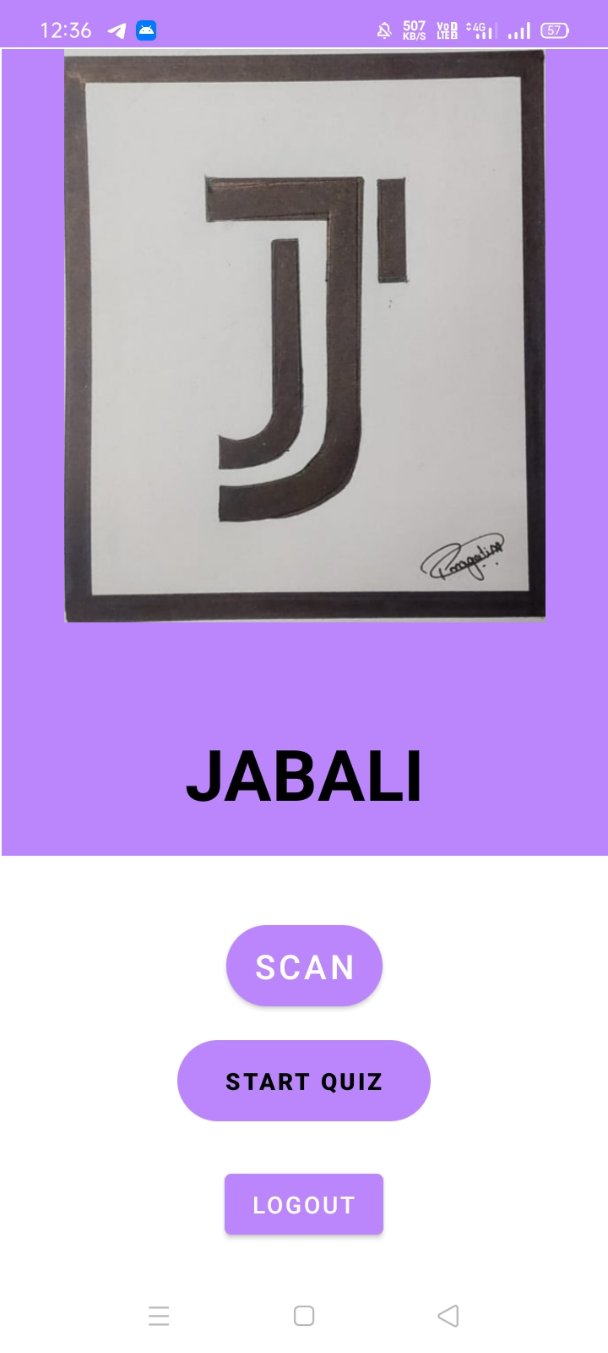
Hey there! New user.
When the user finally signs into the app the following screen would be displayed on their device:

Slide 12
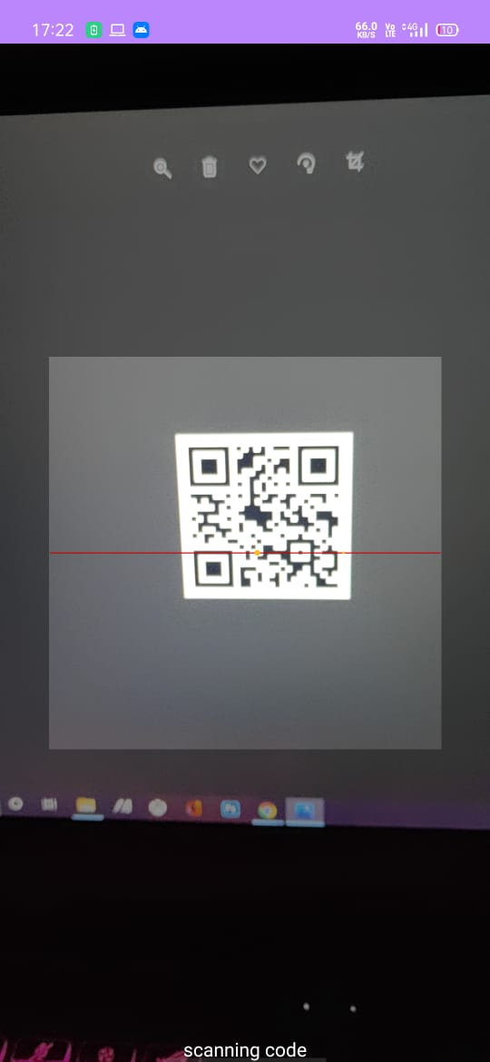
2. SCANNING THE CODE:
PART 1:
When the user reaches the location, he/she will find a QR code, which when scanned through the app will take them to the quiz section of the app.

Slide 13
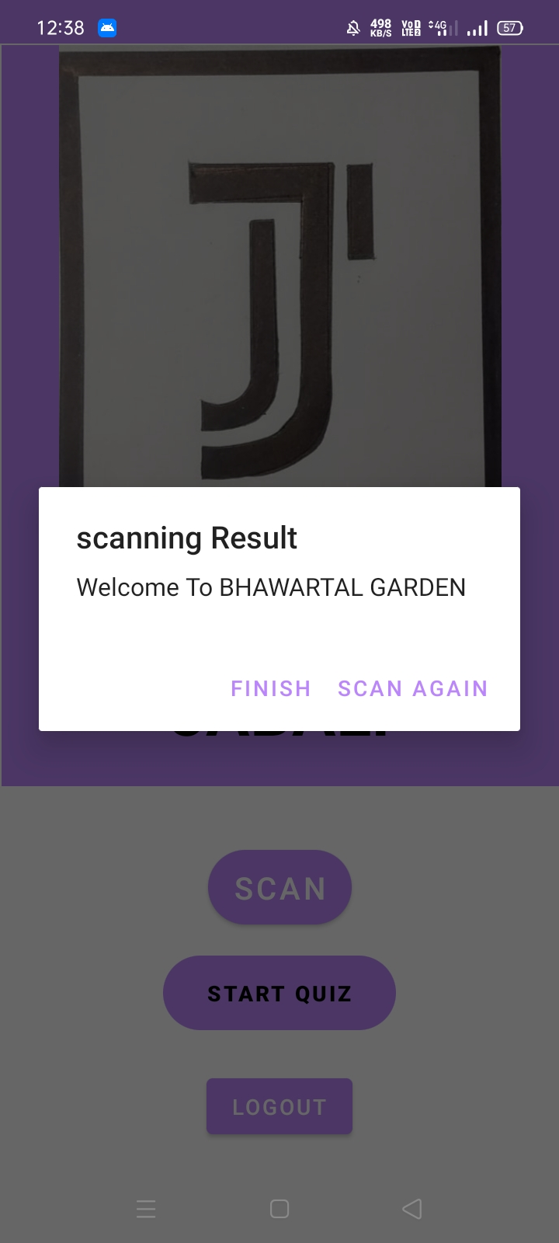
PART 2:
When the code gets scanned, a welcome msg would be displayed telling the user about the place as shown:

Slide 14
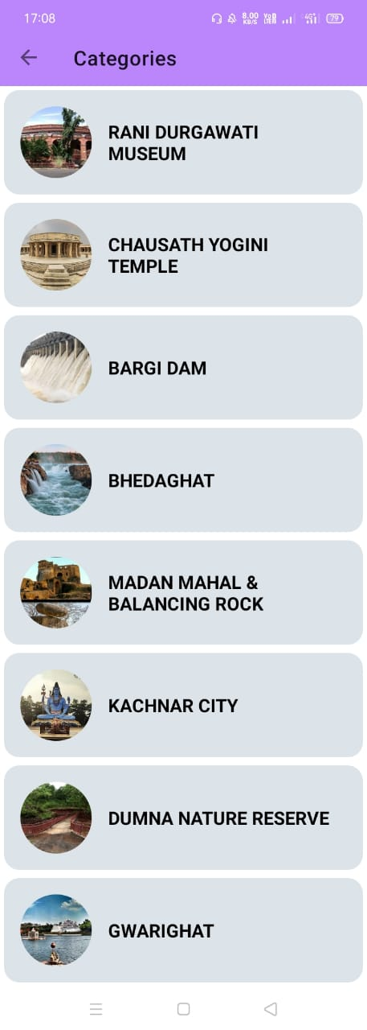
PART 3:
After the user clicks on start quiz
a category list would be opened consisting of all the places, tourist places, monuments where your chosen place would be highlighted as shown:

Slide 15
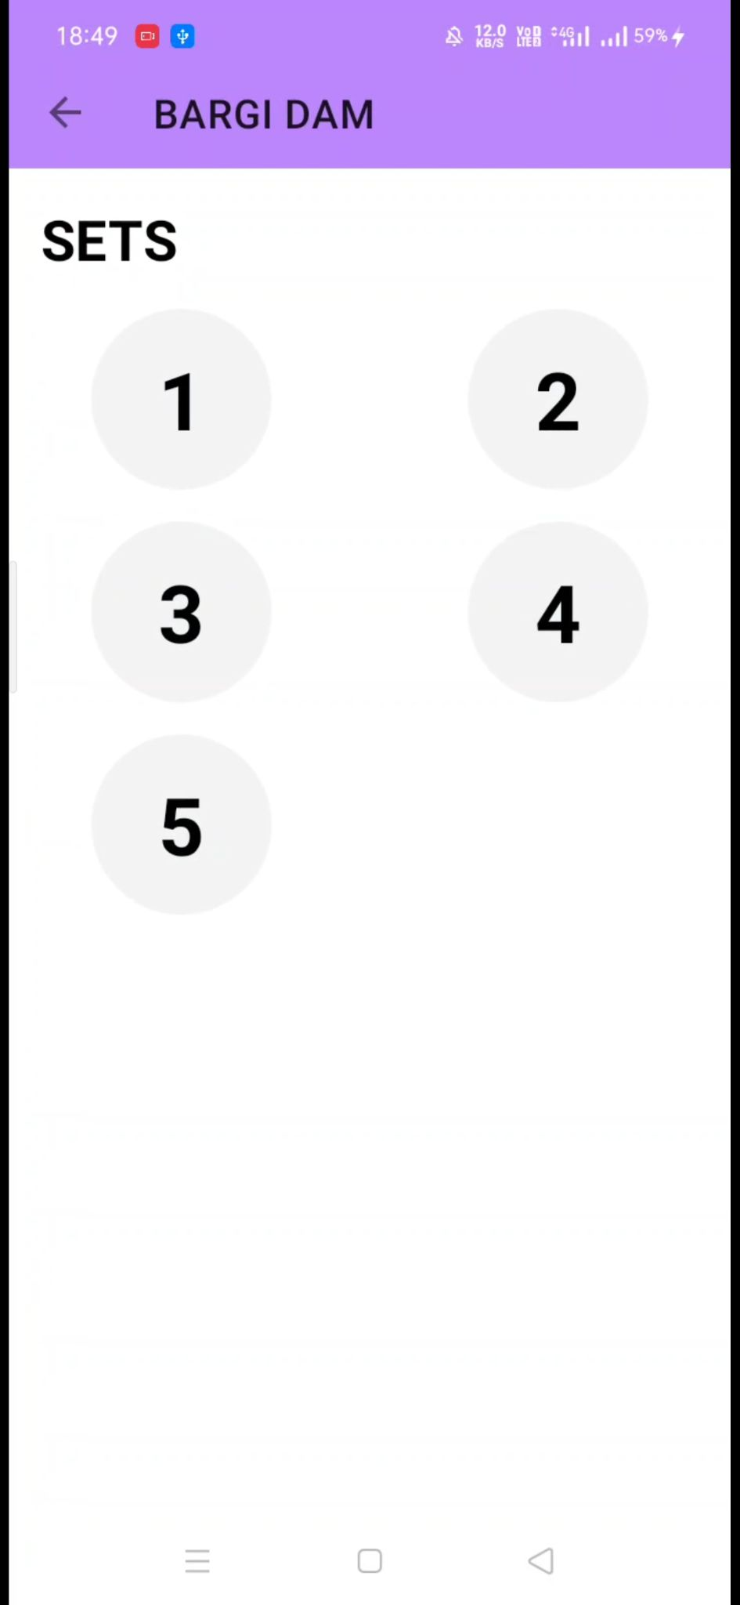
3.PLAYING THE QUIZ:
PART 1:
As soon as the user clicks on his/her selected place(category),
A screenAs containing different sets would popup, where each set has different group of categorie like history, geography, live set etc.

Slide 16
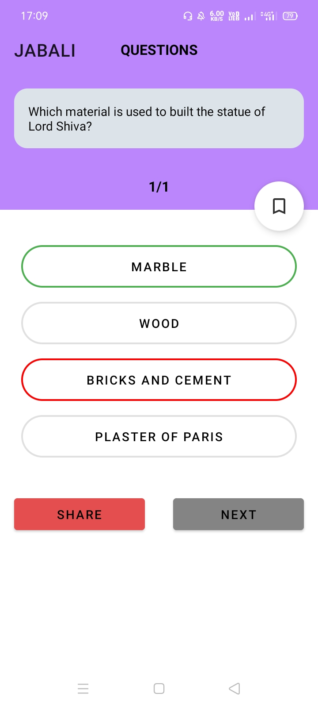
WRONG ANSWER?
If the answer is wrong the user would instantly be informed of the same,
Use the adjacent picture for reference.

Slide 17
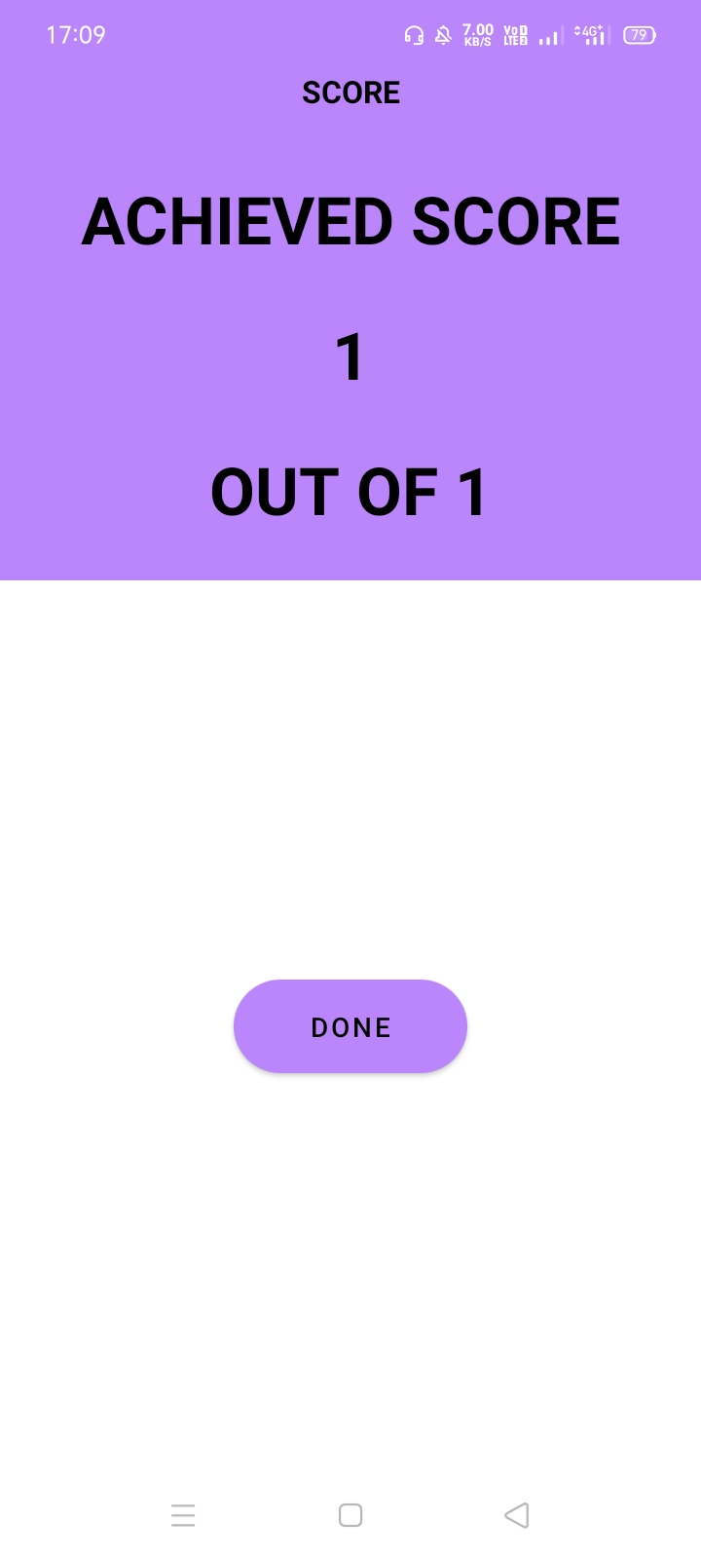
4. REDEEMING YOUR POINTS:
When the user reaches the end of the quiz, their score would be displayed, as follows:

Slide 18
WHY ARE THE POINTS NOT POINTLESS?
What will we do with some virtual points we won in a quiz app? Well every user would ask this question.
Well no need to worry, they can use these points to avail goodies, discounts etc. on some authorised shops which they sure won’t regret.

Slide 19
To elaborate, we plan to have tie-ups with some local shops, predominantly those selling Historical artifacts and small business owners selling handmade toys, which are purely and proudly Indian hence depicting the Indian values, culture and ethos, along with helping some people be more stable financially.
Likewise this would help the Indian toy market to prosper and strengthen, maybe just a little, but as the great Late Dr. APJ Abdul Kalam said :“YOU HAVE TO DREAM BEFORE YOUR DREAMS COME TRUE”

Slide 20
WHY THIS SOLUTION?
We want everyone in our cities to know about things and places they visited but are still unaware about in some way .We want to conserve them as they represent our heritage and culture ,hence we won’t let them fade away out of people’s minds . This game will once again restore the lost imbalance created by the heavy modernization and influence of western civilization . Therefore bringing back our Indian values as depicted throughout the ages.

Slide 21
THANK YOU
We would like to thank honorable PM Shri Narendra Modi ji ,MHRD and all those associated with TOYCATHON 2021 at any level for providing us this golden opportunity to showcase ourselves, and asses our skills for the benefit of the society. A special thanks to our Mentor Prof. Saurabh Sharma to guide and help us throughout in every aspect of this project.

